Slide 1
Introduction and Overview
NE 795: Advanced Reactor Materials and Materials Performance
Fall 2021
Dr. Benjamin Beeler

Slide 2
Office Hours
Have generated a survey monkey to set a time for office hours
Right now, tentatively set for Wednesday’s 10-11 am, subject to change pending survey results

Slide 3
Syllabus
Course Overview
In this course we will study the behavior of nuclear materials in advanced reactor environments. Students will be introduced to different advanced reactor systems and the materials that are either currently deployed, or plan to be deployed, within those reactors. Specific material phenomena and material evolution will be particularly emphasized, including, but not limited to: fission gas swelling, constituent redistribution, fission product attack, fission gas bubble superlattice, recrystallization, actinide salt chemistry, and radiation damage accumulation. A particular emphasis will be placed upon advanced fuel forms, however this course will also address advanced cladding and coolant systems.
Topical Outline
Advanced Reactor Systems, Advanced Fuel types
TRISO particles
U-Zr (U-Pu-Zr) metallic fuel
Molten salts
U-Mo and U-Si
Advanced Reactor Cladding
Alternate reactor concepts
DFT for Uranium-based systems

Slide 4
Exams, Projects, Grading
Using the standard NCSU +/- grading system, as broken down in the syllabus
Four quizzes will be conducted during normal class hours – 12.5% each
Two project presentations will be via PPT and conducted during normal class hours – 15%
Final project – 20%
No final exam

Slide 5
Feedback
This is a new course, and I want to make sure that this class is able to meet the needs of the students, provides relevant information, and is taught at a level commensurate with the abilities of the students, and I need your feedback to do that
I will be reaching out for feedback periodically throughout the semester

Slide 6
Brief Bio/Background
Computational Nuclear Materials Scientist
Expertise in advanced nuclear fuels
Ph.D. in Nuclear Engineering from Georgia Tech
Previously a staff scientist at Idaho National Laboratory in Fuel Modeling and Simulation Group
Atomistic simulations: density functional theory and molecular dynamics

Slide 7
Advanced reactor systems

Slide 8
What do I mean by advanced reactors?
Several generations of reactors can be distinguished
Generation I reactors were developed in 1950-60s, and are no longer operational
Generation II reactors are the present US and French fleets and most in operation elsewhere

Slide 9
What do I mean by advanced reactors?
Generation III or III+ have been constructed and typically have:
A more standardized design for each type to expedite licensing, reduce capital cost and reduce construction time.
A simpler and more rugged design, making them easier to operate and less vulnerable to operational upsets.
Higher availability and longer operating life – typically 60 years.
Further reduced possibility of core melt accidents
Stronger reinforcement against aircraft impact than earlier designs, to resist radiological release.
Higher burn-up to use fuel more fully and efficiently, and reduce the amount of waste.
Greater use of burnable absorbers ('poisons') to extend fuel life.

Slide 10
Generation III Reactors
The greatest departure from Gen II reactors is the incorporation passive of safety features
Construction is often modular, allowing for offsite manufacturing and onsite assembly
Examples include AP1000, EPR, ABWR

Slide 11
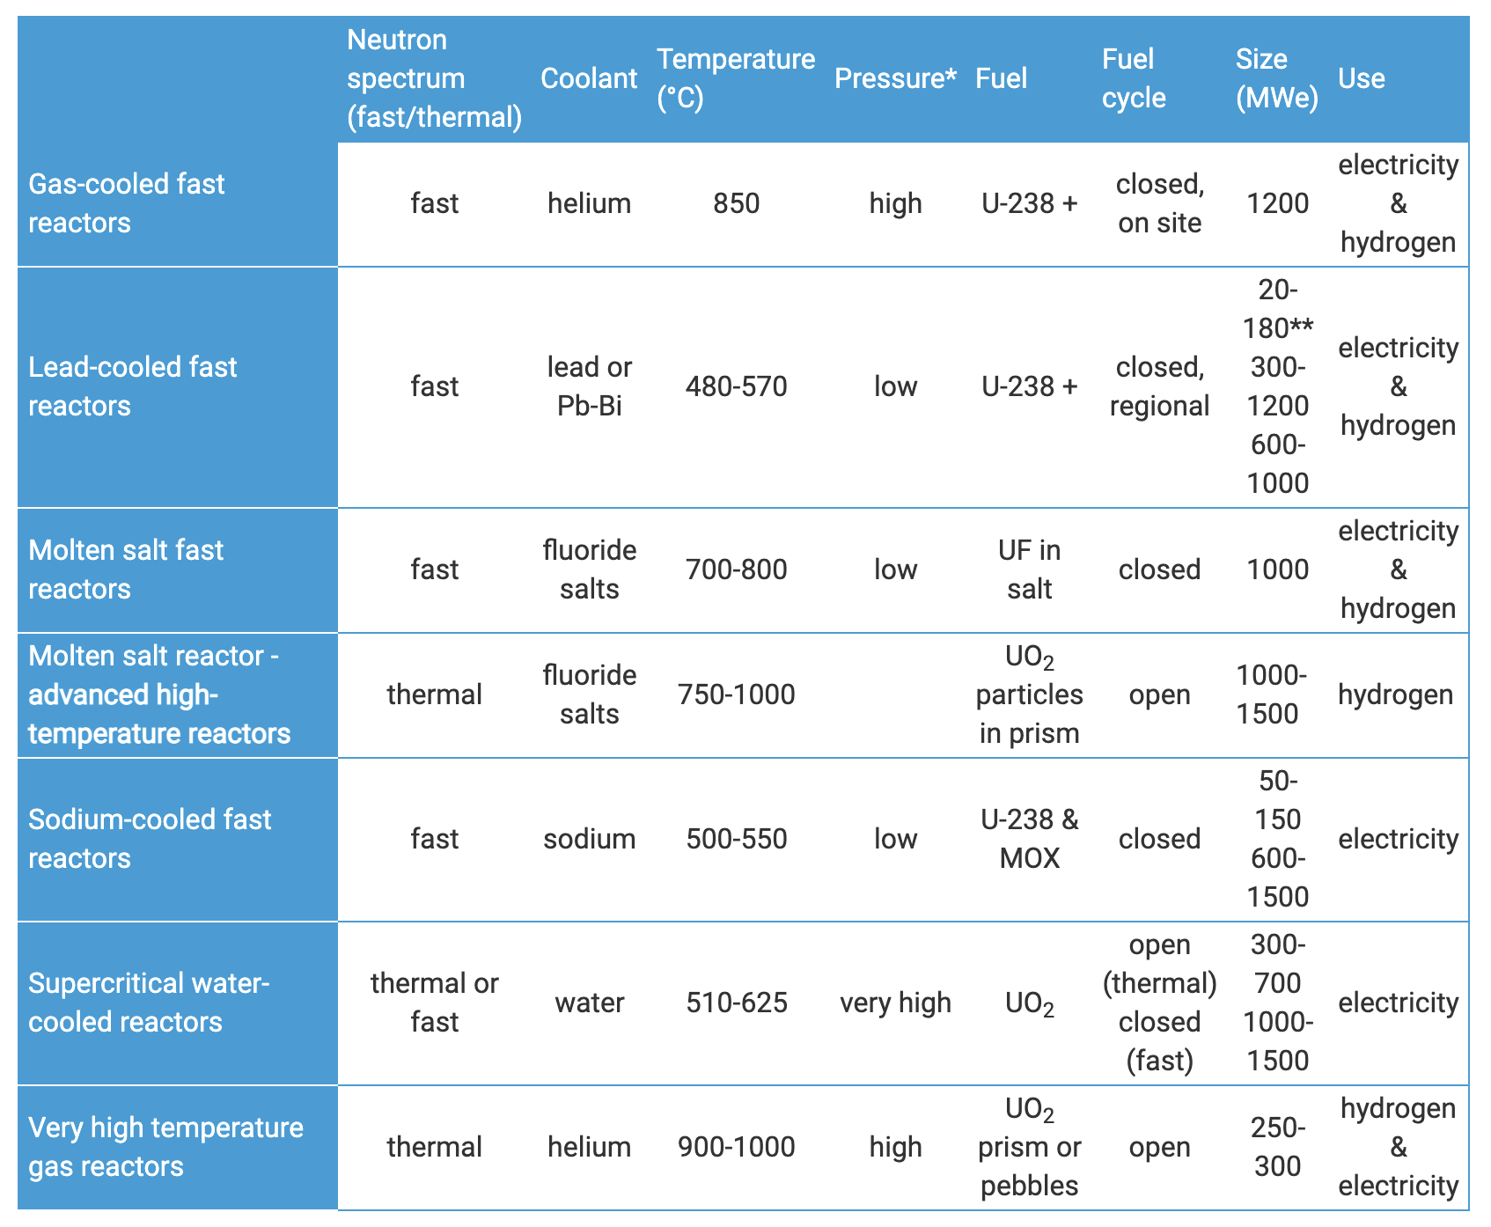
What do I mean by advanced reactors?
Generation IV
designs are still conceptual
typically incorporates six reactor designs
four of these types are fast reactors
all operate at higher temperatures
all six systems represent advances in sustainability, economics, safety, reliability and proliferation-resistance

Slide 12
What do I mean by advanced reactors?
Small Nuclear Reactors
Small Modular Reactors (SMRs)
Micro-Reactors
Reduces the cost associated with building 1000 MW scale reactors, and can provide power away from large grid system
SMRs are 300 MWe or less, designed with modular technology using module factory fabrication, pursuing economies of series production and short construction times
Microreactors (or very small modular reactors vSMRs) are up to 25 MWe

Slide 13
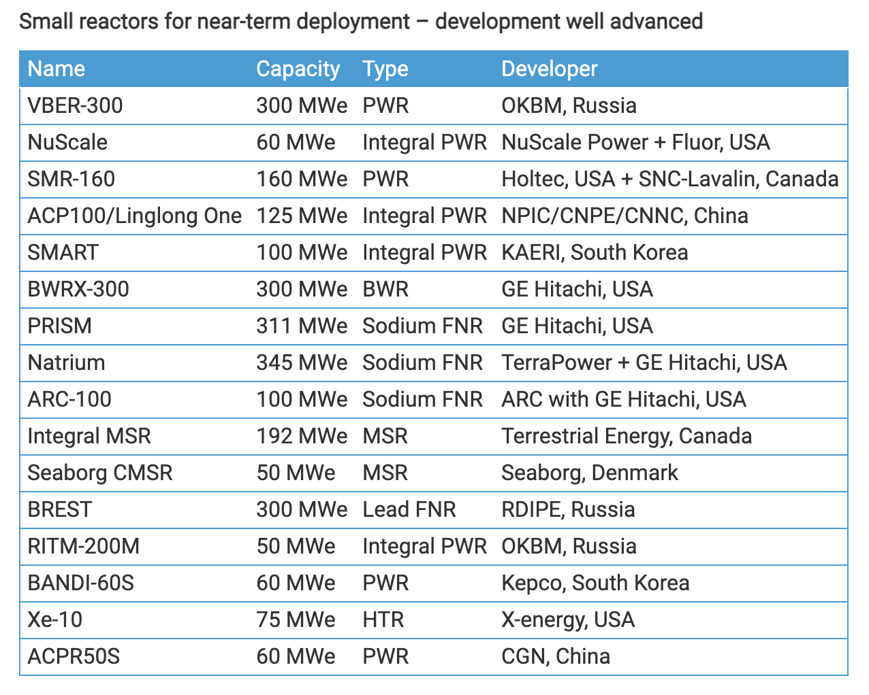
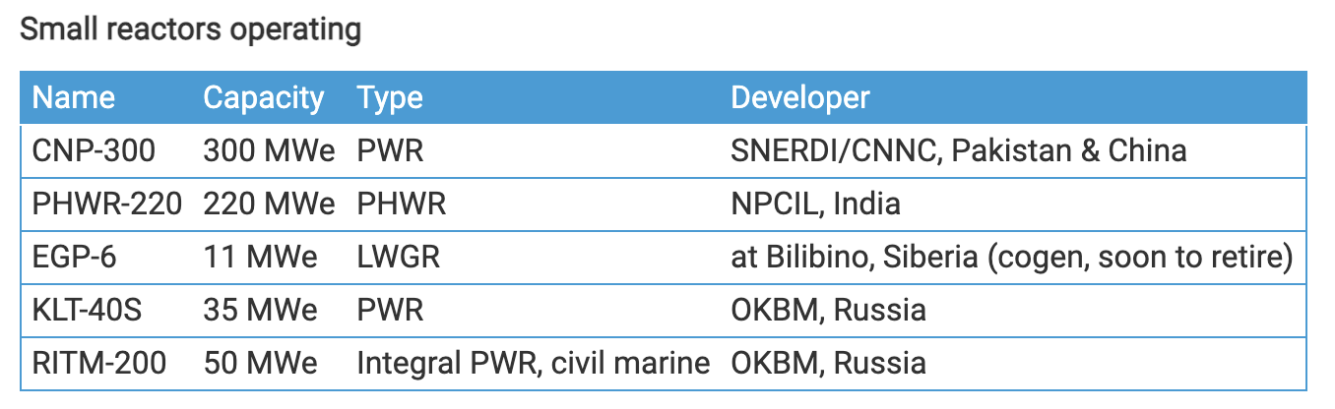
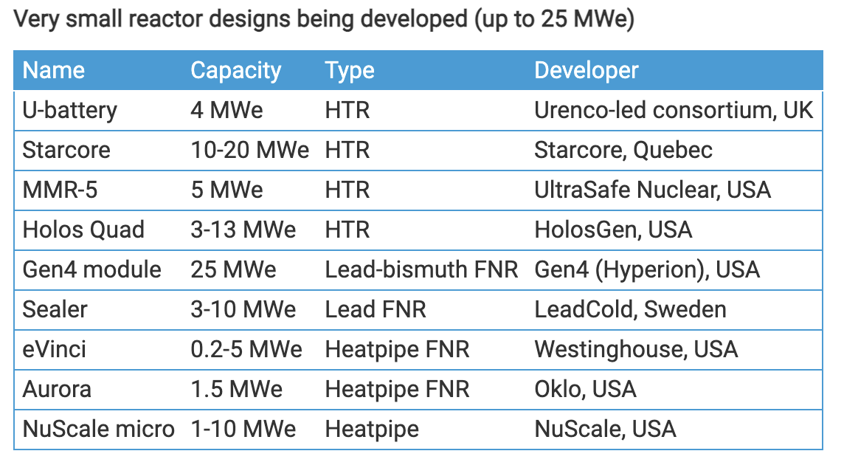
Small Nuclear Reactors

Slide 14
Advanced Reactors in This Course
Generation IV or adjacent concepts:
Sodium cooled fast reactors
Molten salt reactors (both salt cooled and salt fueled)
Gas cooled reactors (both fast and thermal spectra)
Lead cooled reactors
Supercritical water cooled reactors
Research reactors
Many of these concepts have overlap with SNRs

Slide 15
Subject Matter
Explore unique aspects of each reactor type
Identify operational parameter space (temperature, flux, cycle, etc.)
Identify fuel and cladding materials relevant to each reactor design
Explore materials challenges and materials phenomena impacting the deployment and lifetime of advanced reactors

Slide 16
Questions?

